Slide 1
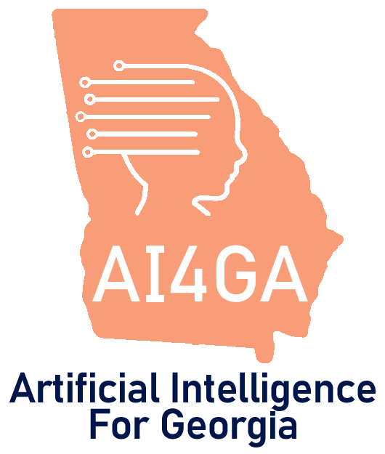
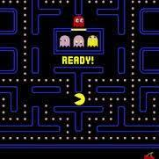

Module 3.1
How do computers make decisions?
Living and Working with Artificial Intelligence
Unit 3
Machine Learning &
Automated Decision-
Making
Developed for the AI4GA (Artificial Intelligence for Georgia) project funded by National Science Foundation awards DRL-2049029 and DRL-2048502.
This work is licensed under the Creative Commons. Attribution-NonComercial-ShareAlike 4.0 International License. https://creativecommons.org/licenses/by-nc-sa/4.0/

Slide 2
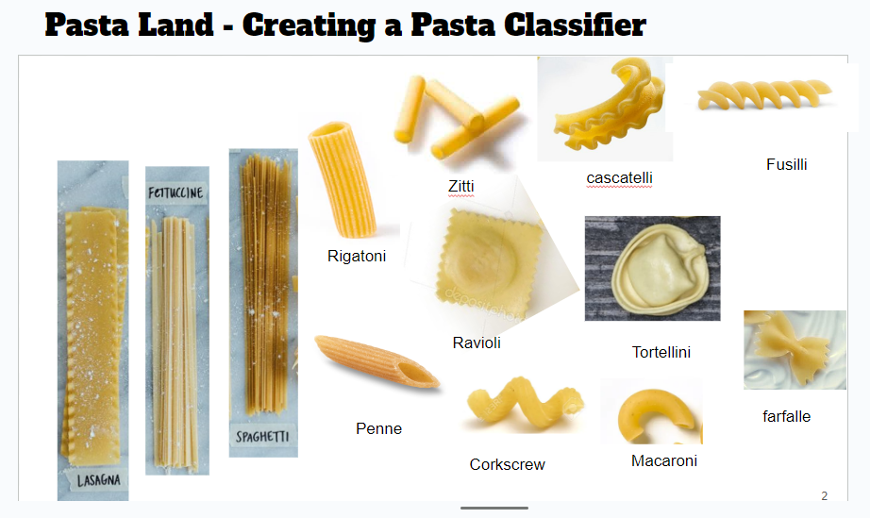
Module 3.2
How can a computer learn to classify objects from examples?
Living and Working with Artificial Intelligence
Developed for the AI4GA (Artificial Intelligence for Georgia) project funded by National Science Foundation awards DRL-2049029 and DRL-2048502.
This work is licensed under the Creative Commons. Attribution-NonComercial-ShareAlike 4.0 International License. https://creativecommons.org/licenses/by-nc-sa/4.0/

Slide 3




Module 3.3a
How do we train a computer to make decisions?
Living and Working with Artificial Intelligence
Fishy Feature Space Activity #1:
Reef vs Non-Reef
Images of Fish on loan from Code.org’s AI for Oceans
Developed for the AI4GA (Artificial Intelligence for Georgia) project funded by National Science Foundation awards DRL-2049029 and DRL-2048502.
This work is licensed under the Creative Commons. Attribution-NonComercial-ShareAlike 4.0 International License. https://creativecommons.org/licenses/by-nc-sa/4.0/

Slide 4


Module 3.3b
How do we train a computer to make decisions?
Living and Working with Artificial Intelligence
Fishy Feature Space Activity#2: Safe vs Poisonous
Developed for the AI4GA (Artificial Intelligence for Georgia) project funded by National Science Foundation awards DRL-2049029 and DRL-2048502.
This work is licensed under the Creative Commons. Attribution-NonComercial-ShareAlike 4.0 International License. https://creativecommons.org/licenses/by-nc-sa/4.0/

Slide 5
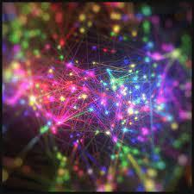
Module 3.4
Machine Learning with Datasets
Living and Working with Artificial Intelligence
Developed for the AI4GA (Artificial Intelligence for Georgia) project funded by National Science Foundation awards DRL-2049029 and DRL-2048502.
This work is licensed under the Creative Commons. Attribution-NonComercial-ShareAlike 4.0 International License. https://creativecommons.org/licenses/by-nc-sa/4.0/

Slide 6
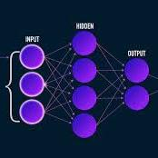
Module 3.5
Neural Networks
Living and Working with Artificial Intelligence
Developed for the AI4GA (Artificial Intelligence for Georgia) project funded by National Science Foundation awards DRL-2049029 and DRL-2048502.
This work is licensed under the Creative Commons. Attribution-NonComercial-ShareAlike 4.0 International License. https://creativecommons.org/licenses/by-nc-sa/4.0/

Slide 7
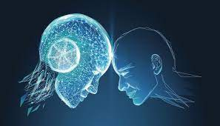

Module 3.6
Case Study: Does AI Make Better Decisions than People?
Living and Working with Artificial Intelligence
Developed for the AI4GA (Artificial Intelligence for Georgia) project funded by National Science Foundation awards DRL-2049029 and DRL-2048502.
This work is licensed under the Creative Commons. Attribution-NonComercial-ShareAlike 4.0 International License. https://creativecommons.org/licenses/by-nc-sa/4.0/

Slide 8
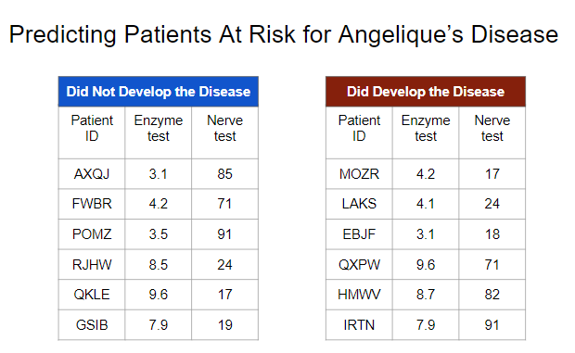
Unit 3 Accelerated Activities
Activity: Angelique’s Disease using Machine Learning for Kids
Living and Working with Artificial Intelligence
Developed for the AI4GA (Artificial Intelligence for Georgia) project funded by National Science Foundation awards DRL-2049029 and DRL-2048502.
This work is licensed under the Creative Commons. Attribution-NonComercial-ShareAlike 4.0 International License. https://creativecommons.org/licenses/by-nc-sa/4.0/

Slide 9
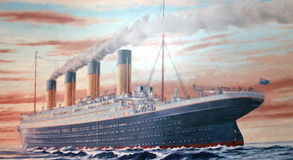
Unit 3 Accelerated Activities
Activity: Titanic Survival Dataset Exploration using Machine Learning for Kids
Living and Working with Artificial Intelligence
Developed for the AI4GA (Artificial Intelligence for Georgia) project funded by National Science Foundation awards DRL-2049029 and DRL-2048502.
This work is licensed under the Creative Commons. Attribution-NonComercial-ShareAlike 4.0 International License. https://creativecommons.org/licenses/by-nc-sa/4.0/

Slide 10
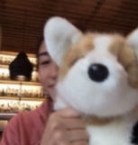


Module 3.7
Mini-Project Overview
Living and Working with Artificial Intelligence
Developed for the AI4GA (Artificial Intelligence for Georgia) project funded by National Science Foundation awards DRL-2049029 and DRL-2048502.
This work is licensed under the Creative Commons. Attribution-NonComercial-ShareAlike 4.0 International License. https://creativecommons.org/licenses/by-nc-sa/4.0/

